Slide 1
Coptic Lesson 15 Possessive Adjectives

Slide 2
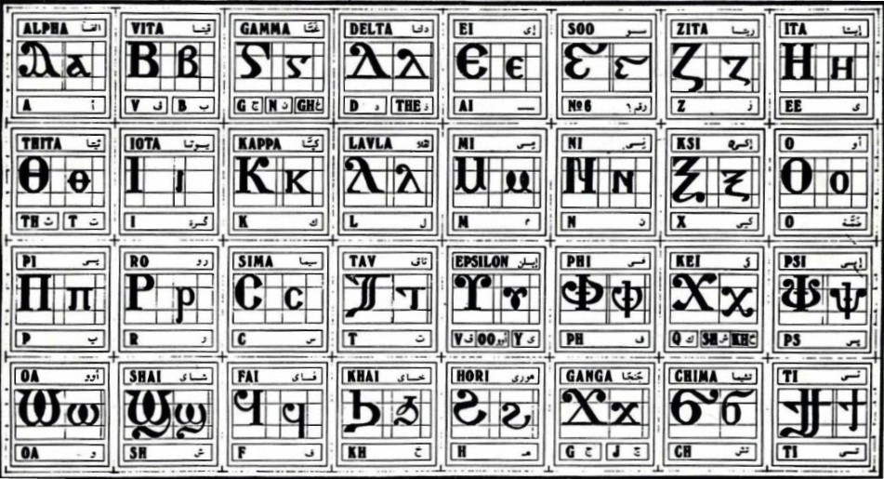
Coptic Alphabets

Slide 3
Review Questions
Coptic
Name
English
i
Iota
e, ee, y
,
Kei
k, sh, kh
`P¡
`P[oic
The Lord
=x=e
ce-`tiou
65
=f^
pictau-coou
96
j
Ganga
g, j
=s
'it-se
900

Slide 4
Rule for the Delta D
d
(in names)
D d =
z
(otherwise)
Examples:
doxa
dikeoc
Dauid
dwron
Daniyl
demwn

Slide 5
Coptic Bible Verses – Part 3
Rasi qen `P[oic `ncyou niben Rejoice in the Lord always. (Phil 4:4)
Twbh `ejen neten`eryou Pray for one another. (Jm 5:16)
Vnou] ouagapy pe God is love. (I Jn 4:16)
Jemnom] anok ai[ro `epikocmoc Be of good cheer, I have overcome the world. (Jn 16:33)
}ar,y `n]covia ]ho] `nte `P[oic te The fear of the Lord is the beginning of wisdom. (Ps 110:10)

Slide 6
Beginner Vocabulary Review
romi kahi `Vnou] `alou ioh
ry con syri iwt bal
yi ran ro ouro nyb
`chimi vorsi seri ourw ri
cwni ajp ve sau soury
mau ]`alou jij `;nyb hiomi
nicwni nirwmi niran nimau ni`alou
jom niourw nibal nisau ninyb
niseri totc io] ourwou vyou`i

Slide 7
Singular Masculine Possessed Noun
paran
pekran
peran
pefran
pecran
penran
petenran
pouran
my name
your name (masculine)
your name (feminine)
his name
her name
our name
your name (plural)
their name

Slide 8
Singular Feminine Possessed Noun
tavorsi
tekvorsi
tevorsi
tefvorsi
tecvorsi
tenvorsi
tetenvorsi
touvorsi
my table
your table (masculine)
your table (feminine)
his table
her table
our table
your table (plural)
their table

Slide 9
Plural Possessed Noun
natotc
nektotc
netotc
neftotc
nectotc
nentotc
netentotc
noutotc
my chairs
your chairs (masculine)
your chairs (feminine)
his chairs
her chairs
our chairs
your chairs (plural)
their chairs

Slide 10
Exercise (Part 1)
Translate the following into English:
paiwt
My father
pekiwt
Your father
tamau
My mother
na`cnyou
My brothers
tetencwni
Your sister (Plu.)
pecsyri
Her son
naio]
My fathers
nenbal
Our eyes

Slide 11
Exercise (Part 2)
Translate the following into English:
My name
paran
Your son
peksyri
My wife
tahiomi
My brothers
na`cnyou
Your cats (Plu.)
tetensau
Her man
pecromi
My hands
najij
Our watches
nenajp

Slide 12
Announcement
All slides are available at http://www.ekladious.com/coptic.html

Slide 13

Oujai qen `P[oic

